Slide 1
BUILDING A WEB SERVICE FRAMEWORK (STOW-RS) FOR MEDICAL IMAGING
NAME: Neha Pathapati
USN: 1MS12CS143
COMPANY: Philips
BUSINESS UNIT: Health Systems
INTERNAL GUIDE: Prof. Srinidhi .H
(Assistant Professor, Dept. of Computer Science and Engineering, MSRIT)

Slide 2
AGENDA
The following topics of STOW-RS will be covered.
A BRIEF OVERVIEW
MOTIVATION FOR STOW-RS
THE DICOM STANDARD
PROBLEM DEFINITION
SYSTEM REQUIREMENTS
LITERATURE SURVEY
DESIGN
PROJECT PLAN
CONCLUSION
REFERENCES

Slide 3
A BRIEF OVERVIEW
Systems responsible for handling medical and patient related information in n healthcare organization are:
HOSPITAL INFORMATION SYSTEM (HIS)
Administrational, medical, financial, legal issues, and the corresponding processing of services.
Patient ID, admitting/registration, billing.
Common source of information of a patient’s health history.
Maintaining confidentiality.
Termed “MASTER SYSTEM”.
MODALITY/PERFORMING RESOURCE
Equipment providing an imaging service.
Ex: CT, MRI, Angiography.
PICTURE ARCHIVAL AND COMMUNICATION SYSTEM (PACS)
Electronic management of images and related information.
Long-term storage of medical images.
Facilitates sharing of images between physicians/radiologists.
RADIOLOGY INFORMATION SYSTEM (RIS)
Subset of the HIS.
Computerized database to store, manipulate, and distribute patient radiological data and imagery.
Scheduling, execution, completion patient exams.
REVIEW WORKSTATION
Radiologist dictates a report for the patient based on – a review of the patient’s history, the patient’s radiological history, and the images of the current exam.

Slide 4
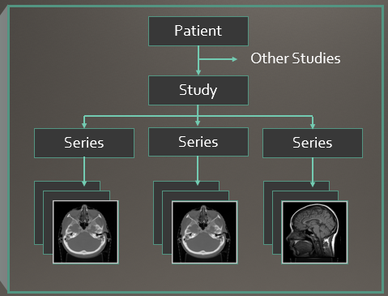
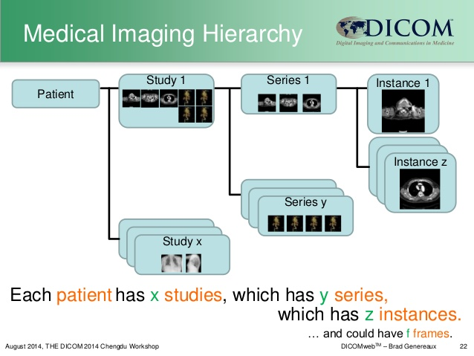
A BRIEF OVERVIEW
RELATION BETWEEN STUDY, SERIES, AND INSTANCE

Slide 5
A BRIEF OVERVIEW
PACS is the most critical system to a healthcare organization!
RELATION B/W HIS, RIS, MODALITY, PACS, AND REVIEW WORKSTATION
SIGNIFICANCE OF PACS
Bring an end to the use of film as the legal mode of archiving medical images.
Serves as “hub” to provide images.
Ends manual relay of medical documents.
Simultaneous access to images and related information, by authorized personnel at any time and from any location.
Computer Aided Diagnostics - Diagnostic and Physician workstations.
Accelerated access to data.
Increase productivity.
Reduce patient stay.
Reduce the need for retakes.
Digital is the future.
Additional scenarios where PACS plays an important role: On-call doctor care, obtaining of 2nd opinion, physician distribution, ICU application.

Slide 6
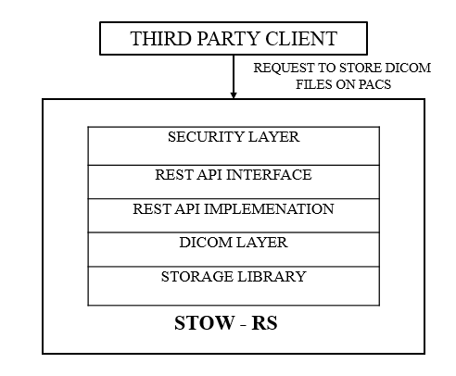
MOTIVATION FOR STOW-RS
CONSIDER THE FOLLOWING SCENARIOS:
Cases when it would be beneficial for external entities to store images on PACS:
Modality not available.
Lack of expertise of doctors.
Diagnostic centers.
2nd medical opinion.
Patient prefers a physician.
Consolidation of reports.
SOLUTION: STOW-RS (Store Over the Web – Restful Service).
WHAT IS STOW-RS?
STOW – RS service facilitates third party clients to post DICOM files (all scans are in compliance with the DICOM standard) to the PACS.
Stores a DICOM file in PACS using RESTful Services.
ARCHITECTURE OF STOW - RS

Slide 7
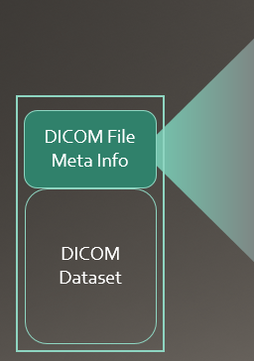
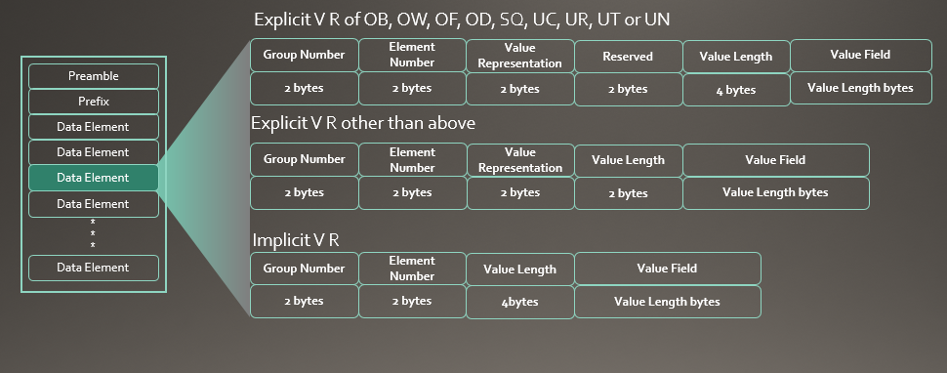
NEED FOR A STANDARD FOR MEDICAL IMAGING
DICOM (DIGITAL IMAGING AND COMMUNICATION IN MEDICINE)
DICOM is a standard for handling, storing, printing, and transmitting information in medical imaging.
It includes a file format definition and a network communications protocol.
The storage and retrieval of images in PACS occurs in DICOM.
Third party storage using STOW-RS also has to be DICOM compliant.
DICOM FILE FORMAT

Slide 8
PROBLEM DEFINITION
The goal of our project is to build a STOW – RS service to facilitate third party clients to post DICOM files (all scans are in compliance with the DICOM standard) to the PACS.
Stores a DICOM file in PACS using RESTful Services.
STOW-RS is intended for distribution of results and images to healthcare professionals.
This action creates new resources for the given SOP Instances on the Server or appends
to existing resources on the Server.
A brief overview of the architecture of STOW is as follows:
The Security Layer - authenticating.
The REST layer - client to access service.
The DICOM Library – validation.
Storage Library - physical storage.
ARCHITECTURE OF STOW - RS

Slide 9
SYSTEM REQUIREMENTS
SERVER SIDE
32 GB RAM
1 TB hard disk
SOFTWARE REQUIREMENTS
.NET Framework 4.5
Internet Information Server (IIS)
DICOM Toolkit license (C#)
STORAGE REQUIREMENTS
NFS (Network File System)
SAN (Storage Area Networks)
NAS (Network Attached Storage)

Slide 10
LITERATURE SURVEY
Reference is Digital Imaging and Communication in Medicine (DICOM) Standard.
This standard was established by the National Electrical Manufacturers Association (NEMA) which recognized the emerging need for a standard method for transferring images and associated information between devices manufactured by various vendors.
The DICOM Standard is an evolving standard and it is maintained in accordance with the Procedures of the DICOM Standards Committee.
The DICOM standard specifies a web-based service i.e. STOW-RS for storing DICOM persistent objects (e.g., images, medical imaging reports).
A simple mechanism for storing a DICOM persistent object, through HTTP/HTTPS protocol, using DICOM UIDs (Unique Identifiers) is described.
The HTTP Request field Content-Type is used in the header lines by the client in an HTTP/1.1 transaction to indicate the type of data being sent to the STOW-RS.
All HTTP header fields whose use is not defined by STOW-RS are assumed to have the meaning defined by the HTTP standard.
The format of the DICOM request message body for DICOM instances including the content-type.
The response of the RESTful Service as a HTTP status line.

Slide 11
DESIGN
ALGORITHM DESIGN
Initialization of DICOM toolkit.
Initialization of logging mechanism.
Host STOW-RS service on port 443 to listen for incoming STOW-RS requests.
A STOW-RS request arrives.
Authorize client. If authorization is successful, accept request. Else, reject request.
Validate format of Study Instance ID from STOW-RS request URL, check consistency of Study UID with DICOM file header tag, and validate format of input DICOM file. If any validation is invalid, abort STOW-RS service.
Retrieve Study Instance ID, Series Instance ID, and SOP Instance ID from DICOM file header (inputted by client to store).
Store the DICOM file at a predefined location in the hierarchy of the form: StudyUID/SeriesID/SopUID.
Construct appropriate HTTP Response Message (status code + status message) and return to client.

Slide 12
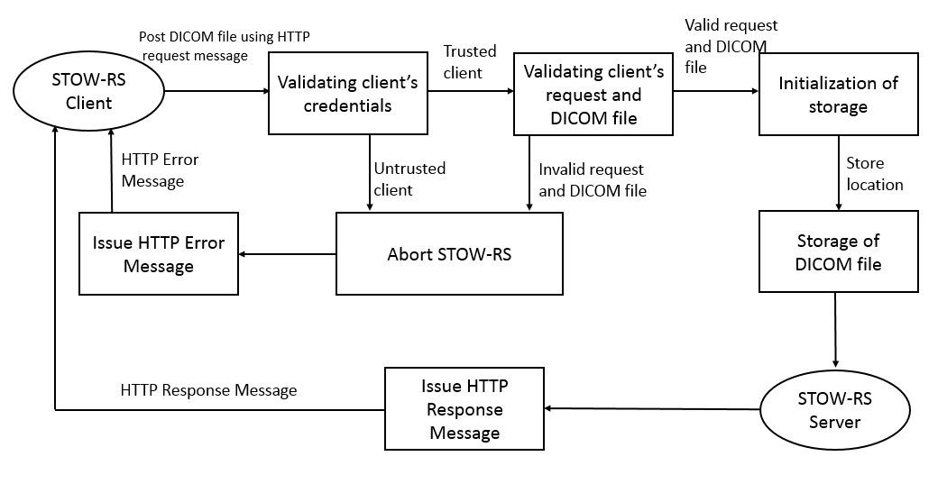
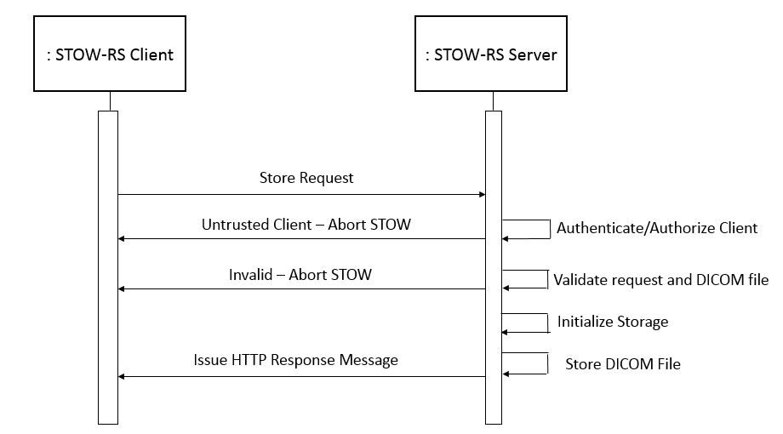
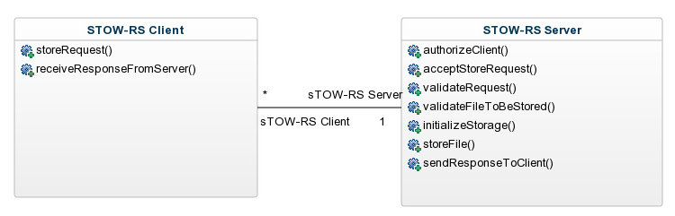
DESIGN
DATA FLOW DIAGRAM
SEQUENCE DIAGRAM
CLASS DIAGRAM

Slide 13
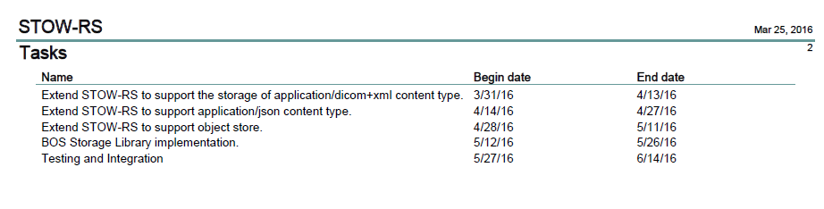
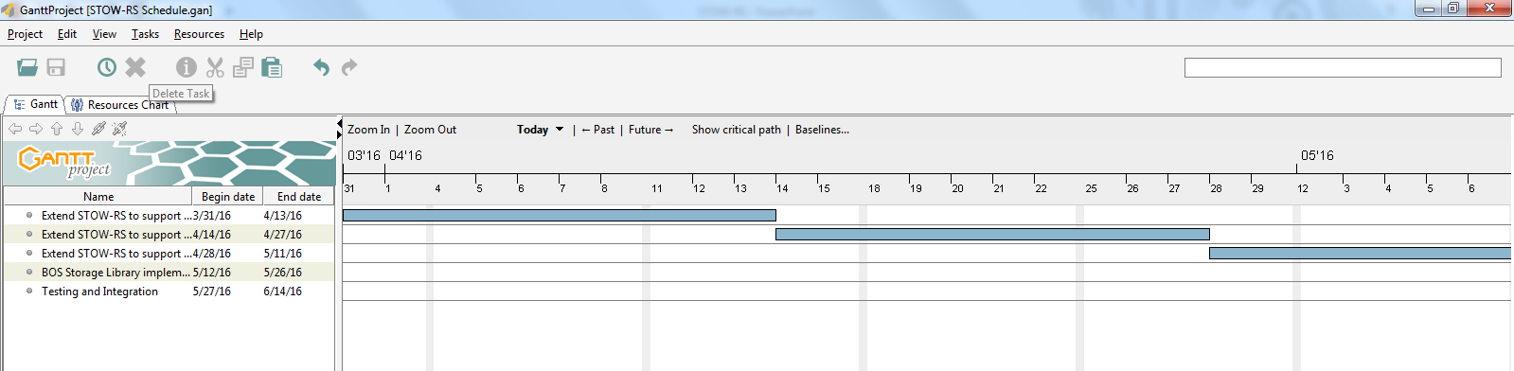
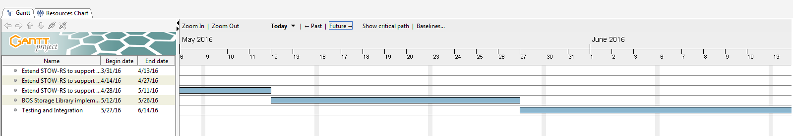
PROJECT PLAN
The schedule for the remaining component of STOW-RS:

Slide 14
CONCLUSION
We are building a STOW-RS web service to allow third party clients to store DICOM files over the PACS.
The successful development of STOW-RS will yield the following benefits:
Easy migration of medical exams across health organizations.
Eliminates the need to manually transfer paper reports from the health organization where the patient has undertaken an exam to his host hospital (i.e. the hospital hosting his general physician).
Saves time, as patient does not have to wait for the exam reports and carry it back to his general/referring physician for diagnosis.
Saves money, as the patient will not need to pay consultation fees twice.
Patient can get diagnosed from his referring physician who is well versed with his medical history, even if he gets a medical exam from another health organization.
All of the patient’s medical exams reports can be consolidated and stored at a single location – his host hospital, for a quick reference in the future.
REFERENCES
Digital Imaging and Communication (DICOM) standard 2015 published by National Electrical Manufacturers Association.

